Slide 1
COVID-19 and North Carolina Communities
Lukas Brun, Colby Hoke, Alexander “Chess” Rosati, Connor Reside
UNC Data Analytics Bootcamp
July 23, 2020
Notes:
(Lukas) 13 words
Hello everyone, we’re Lukas Brun, Colby Hoke, Alexander “Chess” Rosati, and Connor Reside.

Slide 2
Project purpose
Gain a better understanding of how COVID-19 affects different communities in North Carolina.
Notes:
(Lukas) 44 words
So, our team was interested in better understanding how COVID-19 affects different communities in North Carolina.
We wondered whether communities and counties that are more vulnerable would be affected by the disease and what other factors could play a role in cases and deaths.

Slide 3
Initial questions
How prevalent among NC counties are COVID-19 cases?
What are the top 5 counties with COVID-19 cases / deaths?
What are the top 5 counties (per 10,000 population) with COVID-19 cases / deaths?
What community factors explain COVID-19 cases in NC counties?
Are more vulnerable communities more likely to be affected by COVID-19?
Do rural and urban communities show different impacts?
What role do demographics play in COVID-19 cases?
Is there a correlation between access to testing and cases of COVID-19?
Notes:
(Lukas) 78 words
So, we had some initial questions.
We wanted to see how prevalent cases were among NC counties.
Top 5 counties with total cases / deaths.
Top 5 counties for population-adjusted cases / deaths.
What community factors explain cases in NC counties.
Are more vulnerable communities more likely to be affected by COVID-19?
Do rural and urban communities show different impacts?
What role do demographics play in COVID-19 cases?
Is there a correlation between access to testing and cases of COVID-19?

Slide 4
Hypotheses tested
County risk factor
As risk factors increase, COVID incidents increase
Age
As age increases, COVID incidents increase
Race
As % non-white increases, COVID incidents increase
Income
As poverty rate increases, COVID incidents increase
Urban/Rural
As population density increases, COVID incidents increase
Education
As % with high school education decreases, COVID incidents increase
Notes:
(Lukas) 36 words
We had, and tested on, several hypotheses as well.
They’re all outlined here, but we were really interested in cases and deaths as they compare to risk factors, age, race, poverty rate, population density, and education.

Slide 5
Data sources
New York Times COVID-19 data repository
https://github.com/nytimes/covid-19-data
U.S. Census Bureau’s demographic data
https://www.census.gov/quickfacts/fact/table/US/PST045219
U.S. Census Bureau’s measure of community resilience
https://www.census.gov/data/experimental-data-products/community-resilience-estimates.html
https://www2.census.gov/data/experimental-data-products/community-resilience-estimates/2020/
Coders Against COVID (testing center location)
https://github.com/codersagainstcovidorg/covid19testing-backend
Google Maps Geocoding API
https://maps.googleapis.com/maps/api/geocode/json
Notes:
(Colby) 127 words
We used several data sources for our analysis.
New York Times has a great GitHub repository that contains, amongst others, a report on cases and deaths, broken down by county.
The US Census Bureau had 2 key sources of data.
One was their demographic data, which includes measures like population, race, housing, living arrangements, education, and income.
The other Census data is experimental and estimates community resilience and, in their words, “is the capacity of individuals and households to absorb, endure, and recover from the health, social, and economic impacts of a disaster such as a hurricane or pandemic.” We decided to see how accurate those estimates are.
For other analysis, we also used testing center data provided by codersagainstcovid.org and the Google Maps Geocode API.

Slide 6
Process
Identify data sources
Before we combine data sources, rectify any discrepancies in shared data to make sure we’re using the most up-to-date numbers.
Merge all data into a single view, using Python and Pandas.
Generate descriptive and inferential statistics using Python and associated libraries to address our initial questions and test the hypotheses.
See if our hypotheses are correct. Why or why not?
Do additional research to help fill any gaps we may find.
Notes:
(Colby) 97 words
As we dug into this project, once we identified the data sources, we saw potential issues in shared statistics. For example, population numbers. Our data sources had some stats gathered at different times and by different means. So, we worked to make sure our data was as current as possible.
From there, we merged all of our data into a single dataframe that we used to generate our analyses to see if our hypotheses were correct.
We’ll get into this later, but we also did some additional research to help resolve some of the gaps we saw.

Slide 7
Results
Notes:
(Chess) 13 words
So, the moment you’ve been waiting for...the results. What did we find?

Slide 8
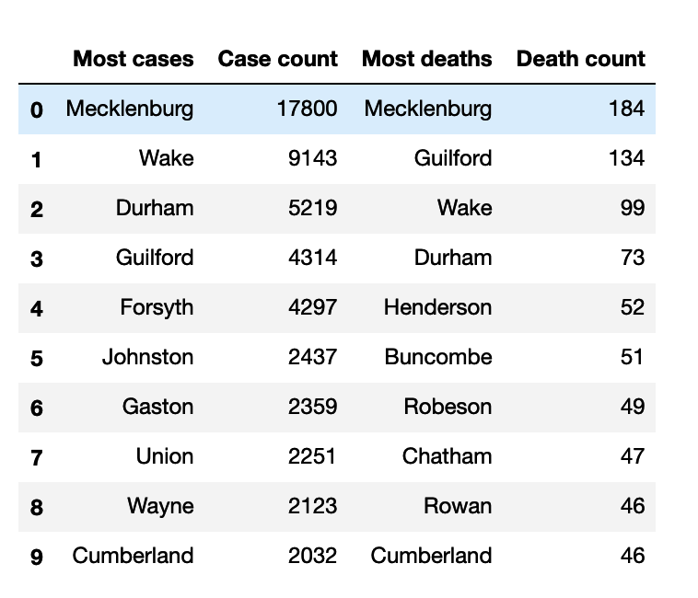
Results: TOP COUNTIES
Measure of top 10 (worst) counties with most overall cases and deaths.
Source: New York Times
Notes:
(Chess) 25 words
Here are our top 10 counties, by cases and deaths. These are just pure total numbers and are not adjusted or normalized in any way.

Slide 9
Results: TOP COUNTIES
Measure of top 10 (worst) counties with most overall cases and deaths.
Source: New York Times
Notes:
(Chess) 36 words
Something interesting here is that Wake County ranks second in overall cases, but third in deaths. Meanwhile, Guilford has less than half the number of cases, and just over a third more deaths, than Wake County.

Slide 10
Results: TOP COUNTIES
Measure of top 10 (worst) counties with most overall cases and deaths.
Source: New York Times
Notes:
(Chess) 83 words
There are some other interesting things happening in this top 10 that we’d need to dig in deeper on the data to understand better. For example, Forsyth has more than 4200 cases and doesn’t make the top 10 in deaths. In fact, 5 counties of the top 10 in cases don’t rank in the top 10 for deaths.
We don’t have answers, but this data does raise quite a lot of questions...
Now on to the combination of data sources and those results.

Slide 11
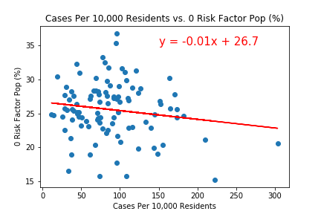
Results: County Risk Factor
R^2: 0.02349
Source: US Census and New York Times
Notes:
(Chess) Risk factor turned out to have a negligible discernable effect on covid cases.
Counties with higher percentages of low risk-factor individuals had slightly lower instances of covid overall, but not at a significant level.

Slide 12
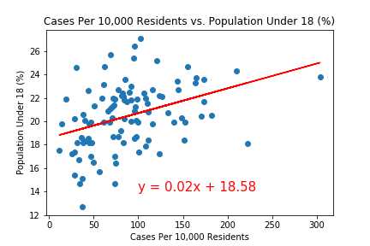
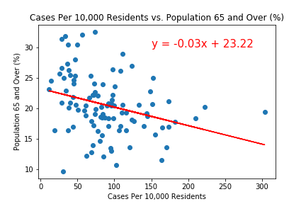
Results: Age
Under 18 R^2: 0.14370
Over 65 R^2: 0.09352
Source: US Census and New York Times
Notes:
(Chess) In examining age we looked at the percentages of people under 18 and over 65 in each county.
We found that higher percentages of children correlated to more cases of covid and higher percentages of senior citizens correlated to less cases of covid.

Slide 13
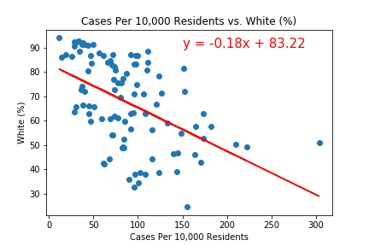
Results: Race
R^2: 0.24682
Source: US Census and New York Times
Notes:
(Chess) Reports that covid has disproportionately affected minorities led us to hypothesize that counties with higher percentages of white residents would have lower instances of covid.
This was supported by our data as we found the largest effect size here, with percentage of white residents explaining nearly 25% of the variation in proportional covid cases.
Personally, I was curious about how covid had effected native American reservations, and our data showed that the two counties with significant native populations, Robeson and Swain county were both roughly average with regard to proportional cases.

Slide 14
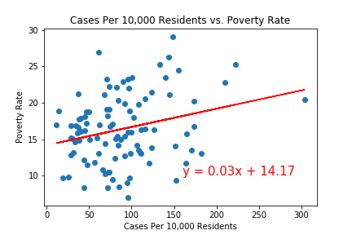
Results: POVERTY RATE
R^2: 0.06992
Source: US Census and New York Times
Notes:
(Connor)
We hypothesized that poverty rate would explain incidents of COVID due to many factors, including access to healthcare, less ability to get testing, and there being a higher percentage of essential workers.
This was supported by our data showing a reasonably strong correlation between the two variables.

Slide 15
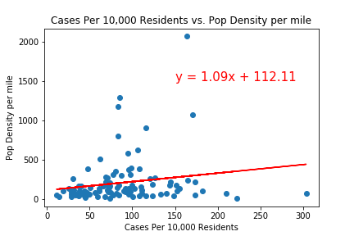
Results: POPUALTION DENSITY
R^2: 0.03217
Source: US Census and New York Times
Notes:
(Connor) We thought that population density might have an effect on the proportional cases of COVID in a county, with more concentration leading to easier spread of the virus.
We found a statistically significant result, though the effect size was small.

Slide 16
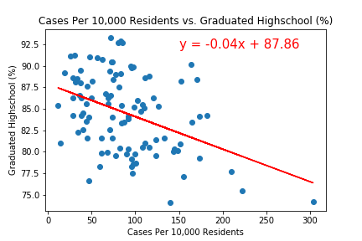
Results: education
R^2: 0.16788
Source: US Census and New York Times
Notes:
(Connor) We thought that percentage of high school graduates in a county would influence proportional cases for much the same reason as we suspected poverty rates would.
However we found a much stronger effects here than we did with poverty rate, with percentage of high school graduates explaining nearly 17 percent of the variation in proportional COVID cases.

Slide 17
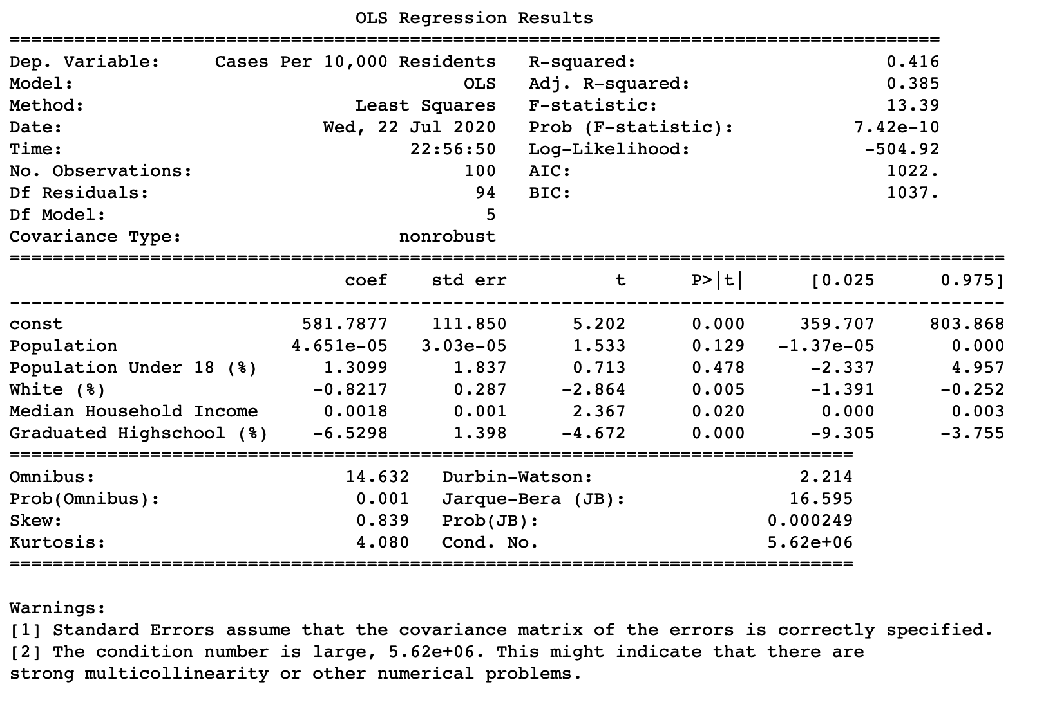
Source: US Census and New York Times
Results: multiple linear regression
Notes:
(Connor) Multicollinearity is when two or more independent variables in a regression are too highly correlated with one another,
which undermines the validity of a multiple linear regression.
Unfortunately, our dependent variables were too highly correlated with one another to perform a valid multiple linear regression.
We investigated this by testing the variable inflation factor, which showed us that all combinations of independent variables had this issue.

Slide 18
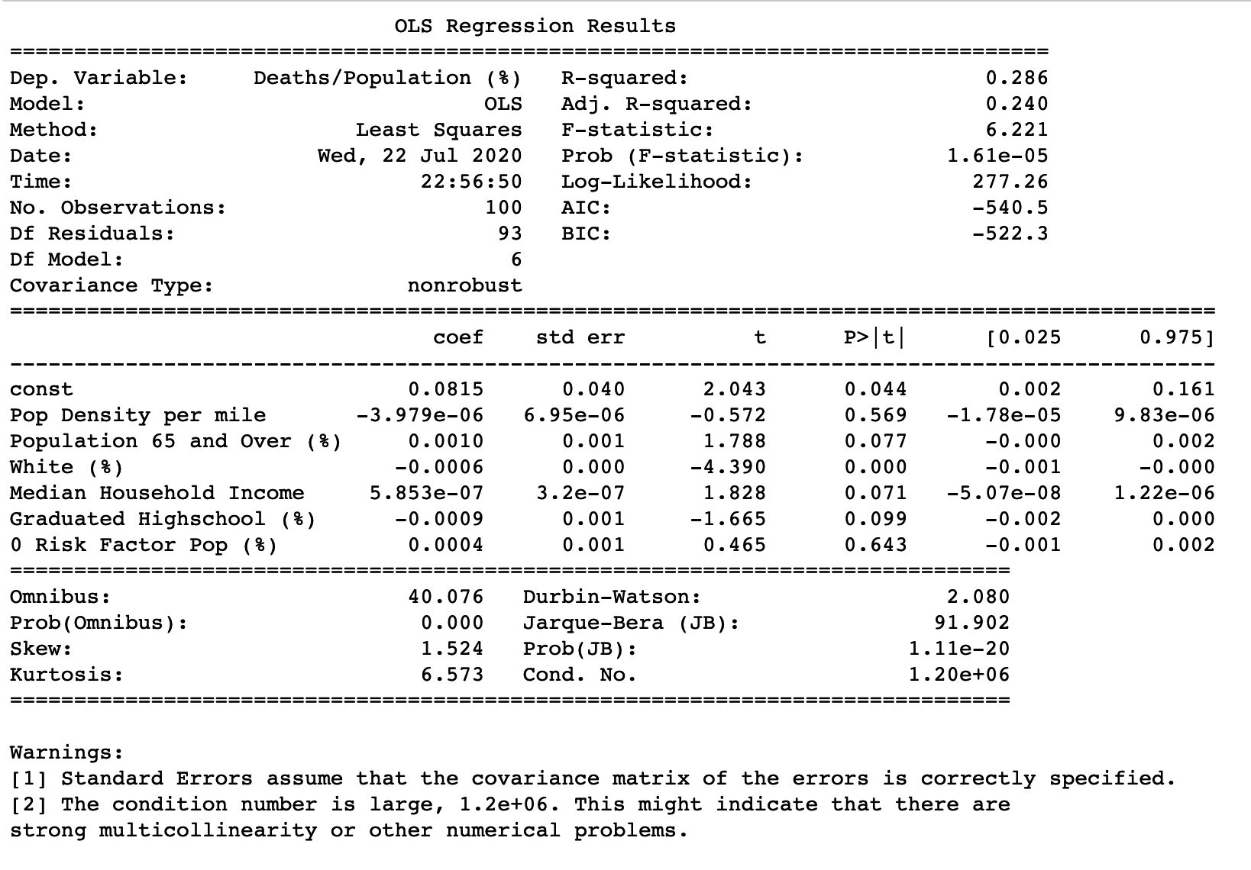
Source: US Census and New York Times
Results: multiple linear regression
Notes:
(Connor) Multicollinearity is when two or more independent variables in a regression are too highly correlated with one another,
which undermines the validity of a multiple linear regression.
Unfortunately, our dependent variables were too highly correlated with one another to perform a valid multiple linear regression.
We investigated this by testing the variable inflation factor, which showed us that all combinations of independent variables had this issue.

Slide 19
CONCLUSIONS

Slide 20
Hypotheses: Answered
County risk factor
As risk factors increase, COVID incidents increase [FALSE]
Age
As age increases, COVID incidents increase [TRUE]
Race
As % non-white increases, COVID incidents increase [TRUE]
Income
As poverty rate increases, COVID incidents increase [TRUE]
Urban/Rural
As population density increases, COVID incidents increase [TRUE]
Education
As % with high school education decreases, COVID incidents increase [TRUE]
Notes:
(Lukas)

Slide 21
EXTRA RESEARCH
Notes:
(Colby)
So, the farther we got into some of this research, we knew there were things that the numbers wouldn’t or couldn’t tell us.
We looked at some of the cases and death reported by NYTimes and wondered if there was a way to see other factors at work.
The first that came to mind, and a fun little data exploration, was looking at testing sites. Fortunately Coders Against COVID has been gathering and keeping an API of testing locations up and running. So, we decided to map out counties, by county seat, as they relate to testing sites.

Slide 22
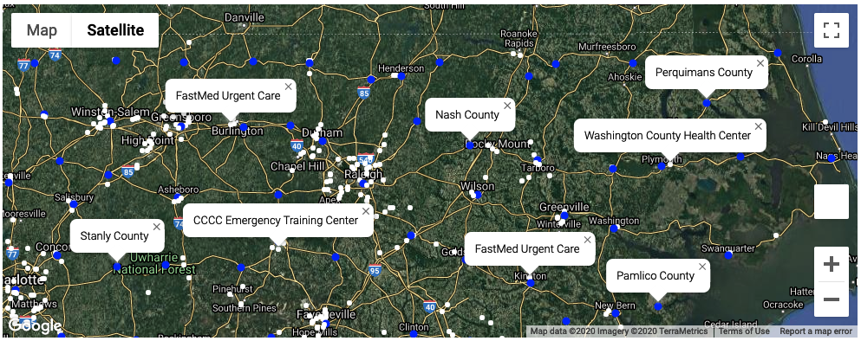
EXTRA RESEARCH: Access to testing
Blue = County seat
White = Testing facilities
Source: Coders Against COVID and Google Maps
Notes:
And here that is. You can see the county seats and testing sites on the same map.
With more time, we’d like to do further analysis that looks for correlation between distance to testing and reporting numbers, etc.
Thank you for your time. That’s it for group 6!

